Slide 1
NETWORK SCANNER TOOLS
VISHAL RAWAT (19BCS1770)

Slide 2
One of very first steps in network reconnaissance mission to reduce a (sometimes huge) set of IP ranges into a list of active or interesting hosts – administrator uses an ICMP ping to locate hosts on internal network – external penetration uses a diverse set of “probes” in an attempt to evade firewall restrictions • Aka “ping” scan, but goes beyond ICMP echo request packets

Slide 3
INTRODUCTION
Network scanning involves detecting all active hosts on a network and mapping them to their IP addresses. Port scanning refers to the process of sending packets to specific ports on a host and analyzing the responses to learn details about its running services or locate potential vulnerabilities (Weak Points).

Slide 4
WHAT IS PORT ? IT’S PURPOSE ?
A virtual point where network connections begin and stop is referred to as a port. The operating system of a computer manages ports, which are software-based. Each port is linked to a particular operation or service. Emails, for example, are sent to a different port than webpages, despite the fact that they both reach a computer over the same Internet connection.
A port is a number used to uniquely identify a transaction over a network by specifying both the host, and the service. They are necessary to differentiate between many diff

Slide 5
PORTS NUMBER
There are 65,535 possible port numbers, although not all are in common use. Some of the most commonly used ports, along with their associated networking protocol, are:
Ports 20 and 21: File Transfer Protocol (FTP). FTP is for transferring files between a client and a server.
Port 22: Secure Shell (SSH). SSH is one of many tunneling protocols that create secure network connections.
Port 25: Simple Mail Transfer Protocol (SMTP). SMTP is used for email.
Port 53: Domain Name System (DNS). DNS is an essential process for the modern Internet
Port 80: Hypertext Transfer Protocol (HTTP). HTTP is the protocol that makes the World Wide Web possible.
Port 179: Border Gateway Protocol (BGP). BGP is essential for establishing efficient routes between the large networks that make up the Internet (these large networks are called autonomous systems).
Port 443: HTTP Secure (HTTPS). HTTPS is the secure and encrypted version of HTTP. All HTTPS web traffic goes to port 443.
The Internet Assigned Numbers Authority (IANA) maintains the full list of port numbers and protocols assigned to them

Slide 6
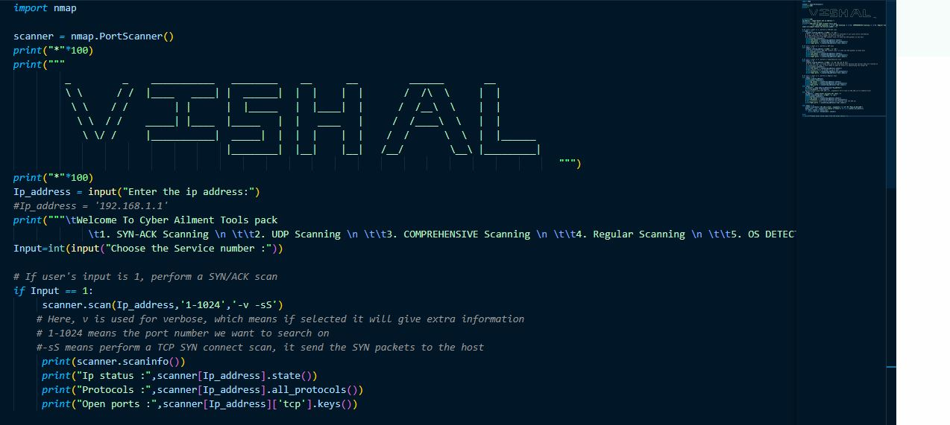
IMPLEMENTATION

Slide 7
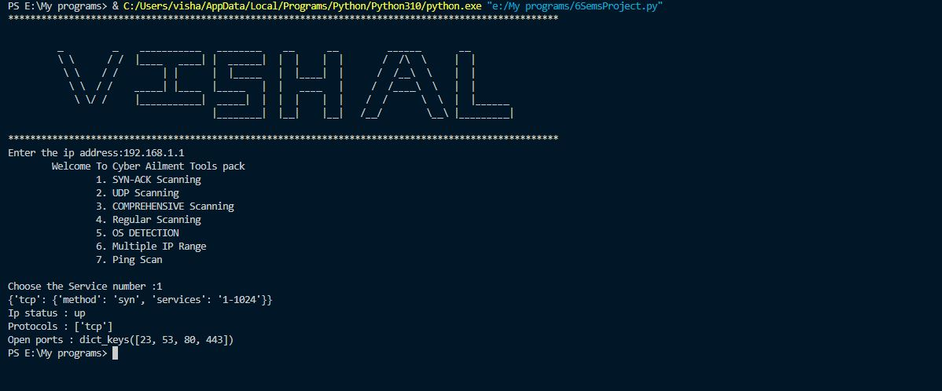
OUTPUT

Slide 8
THANK YOU

